Slide 1

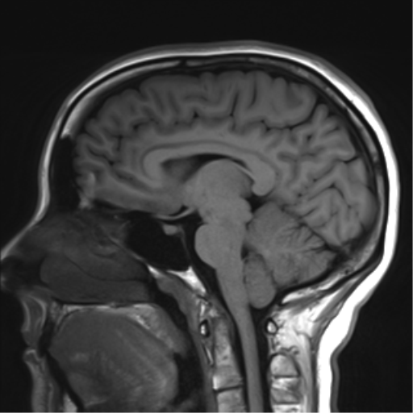
Brainstem and cranial nerves

Slide 2
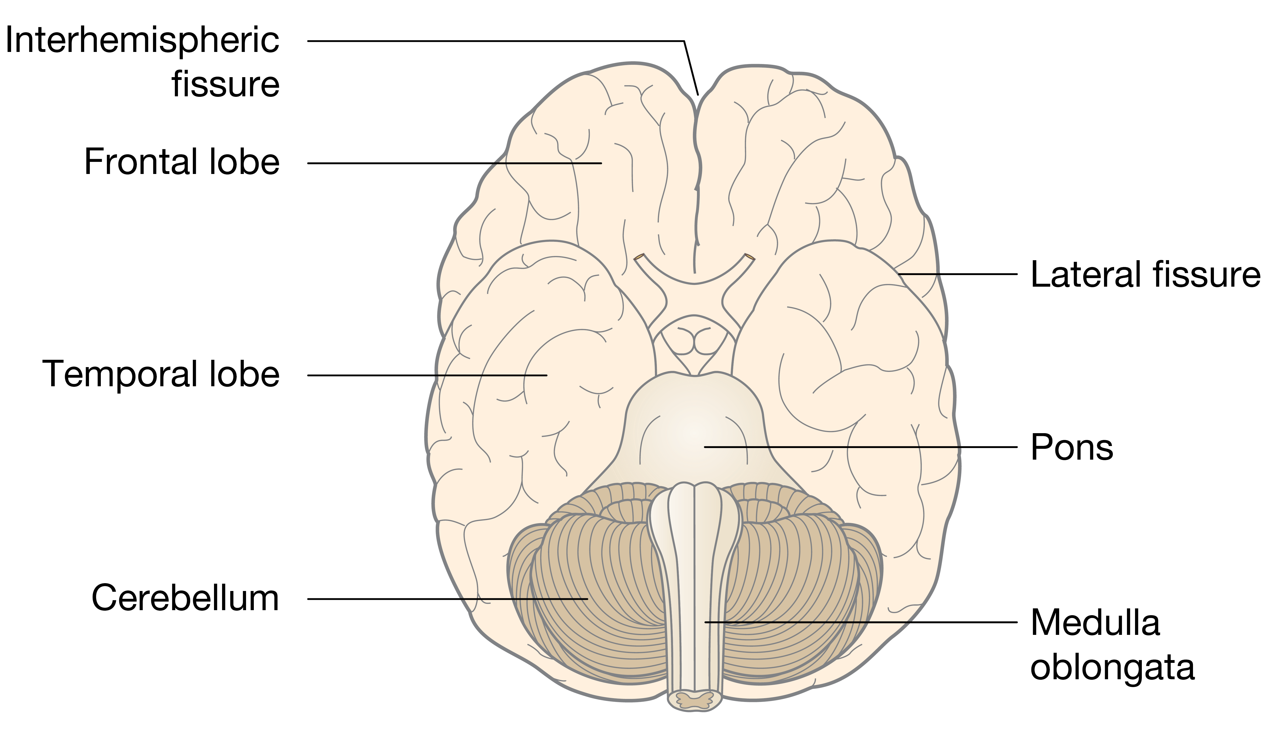
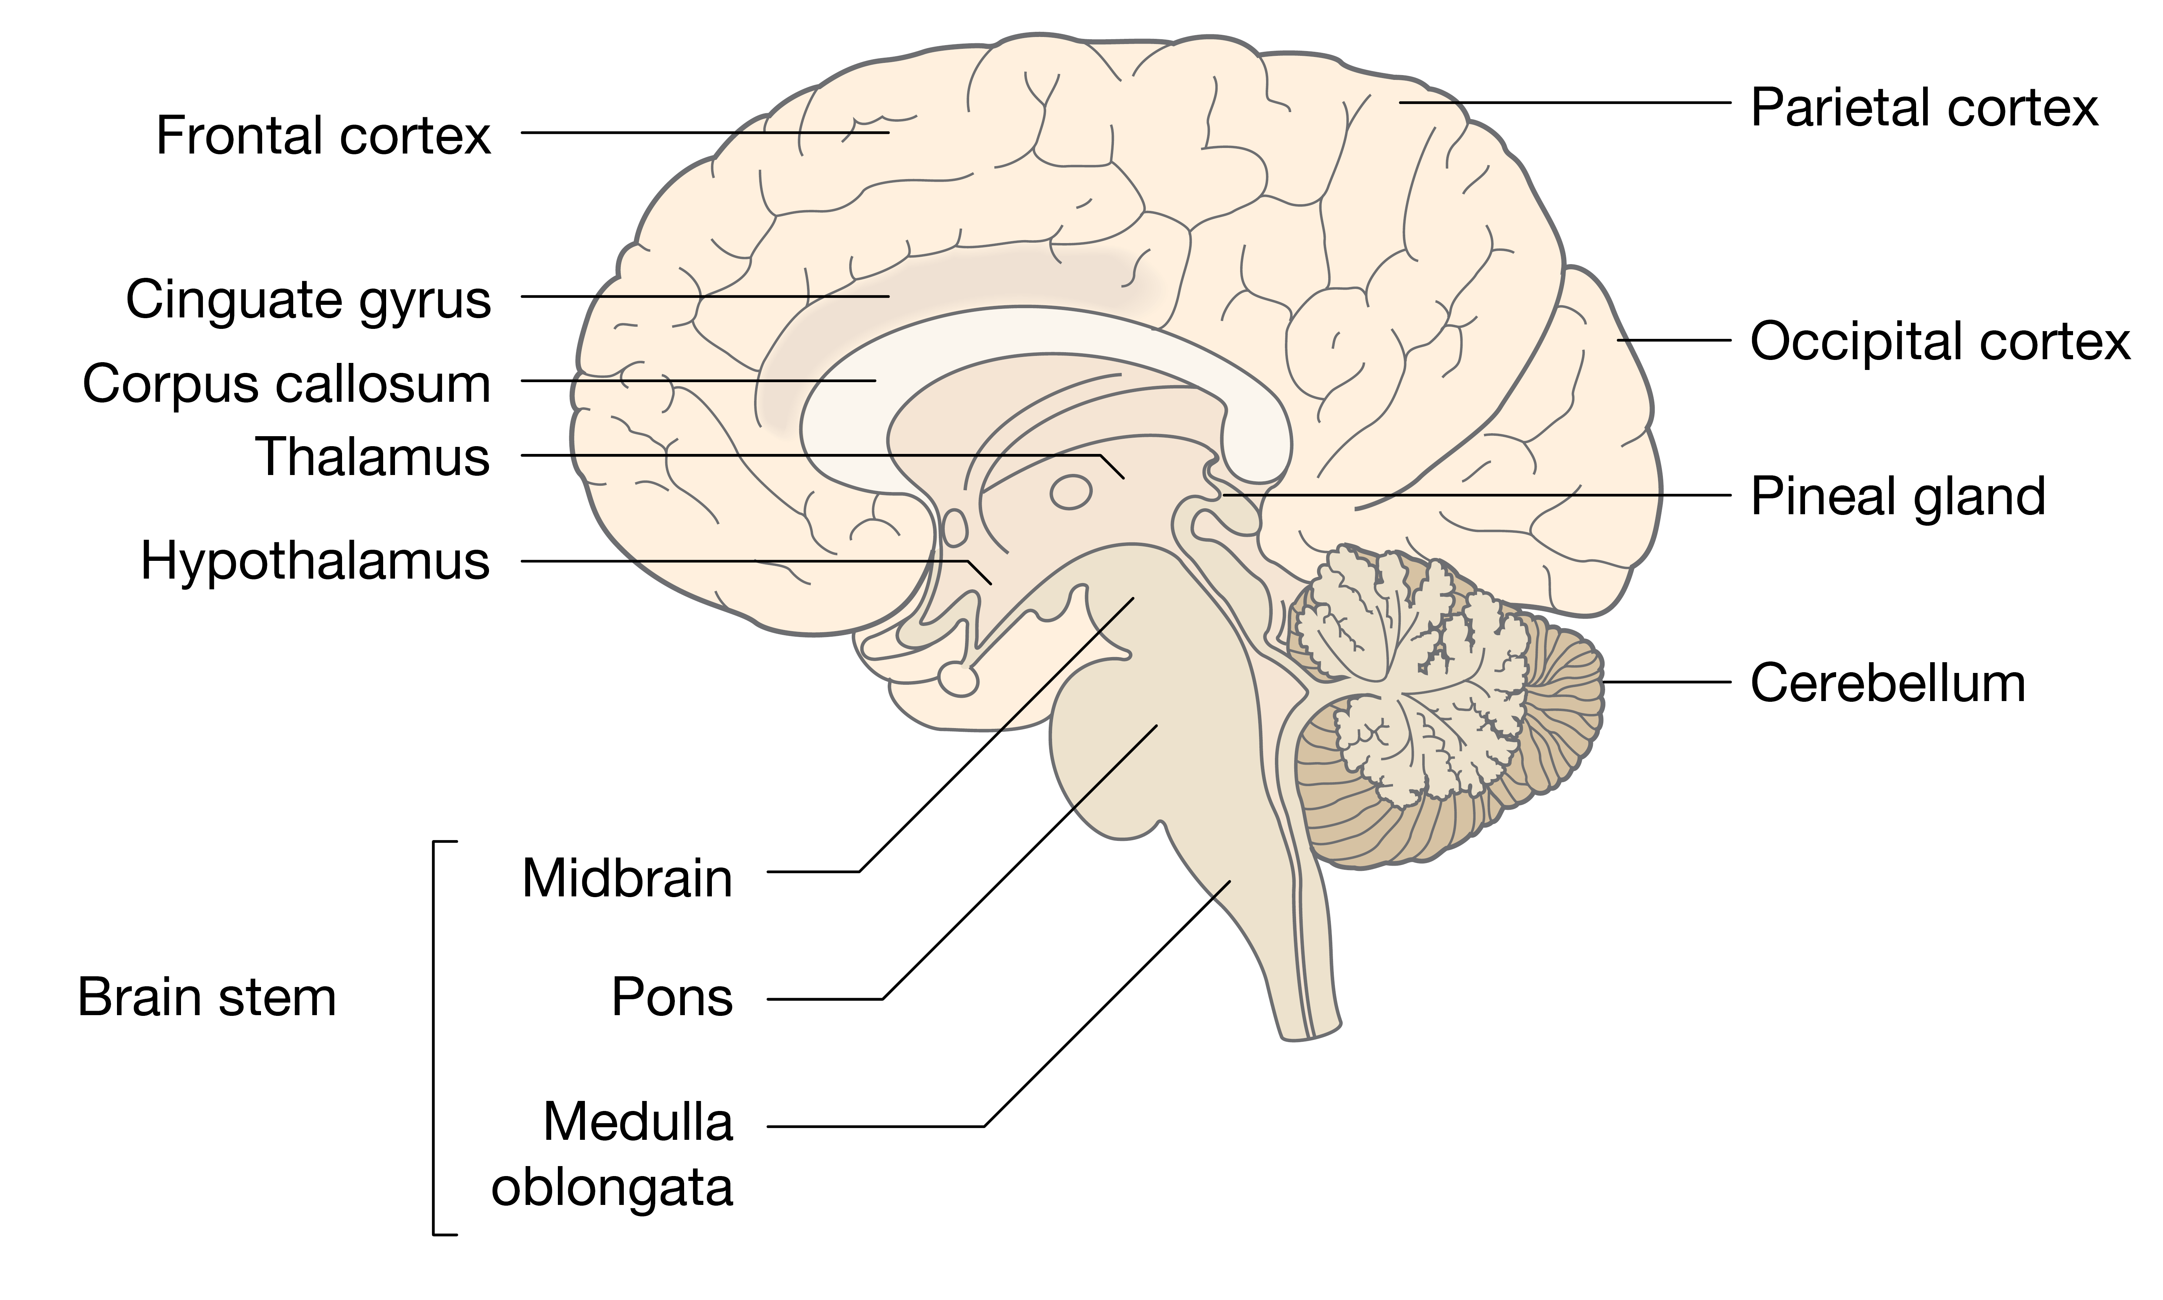
The CNS - Brain
Brainstem
Midbrain
Pons
Medulla Oblungata

Slide 3
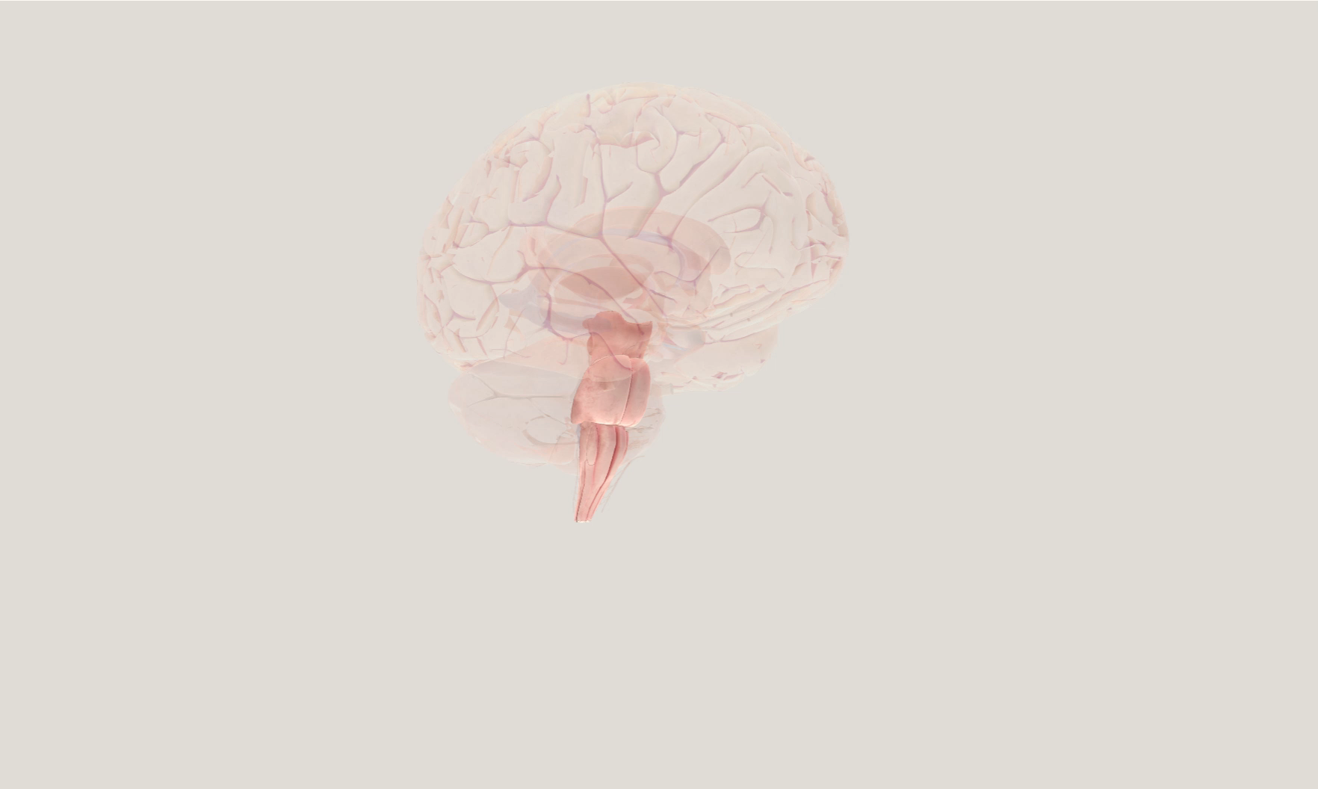
The brainstem

Slide 4
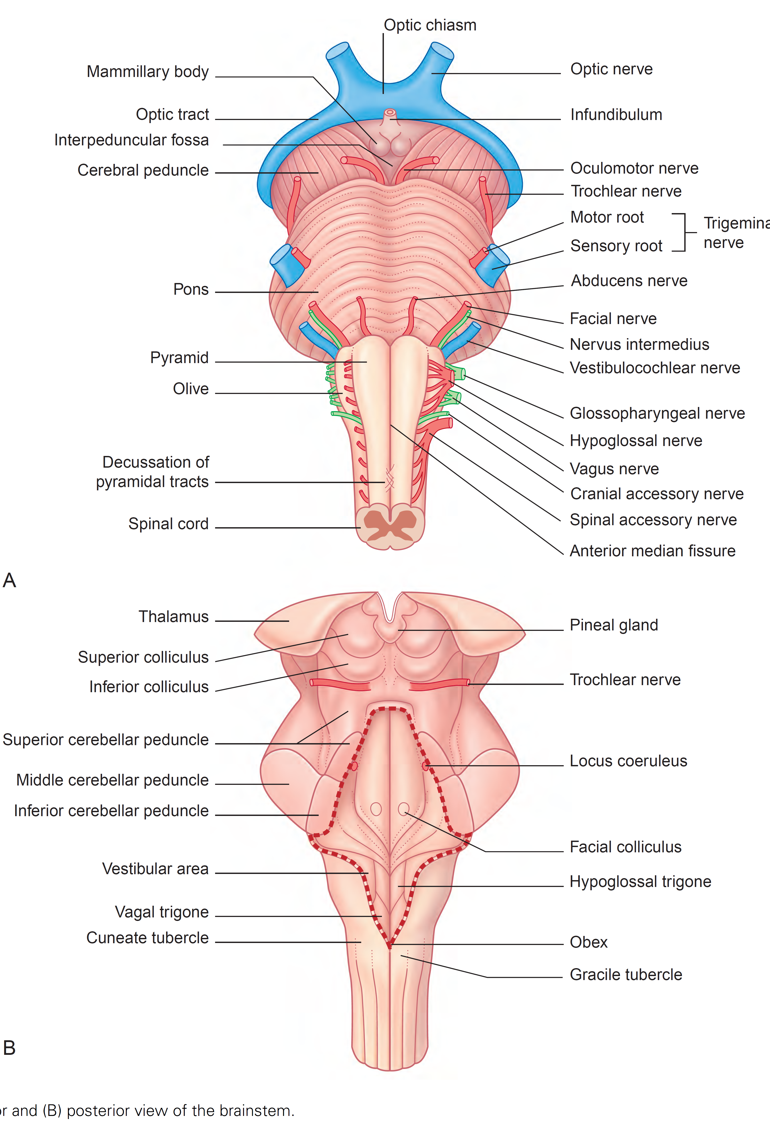
The brainstem

Slide 5
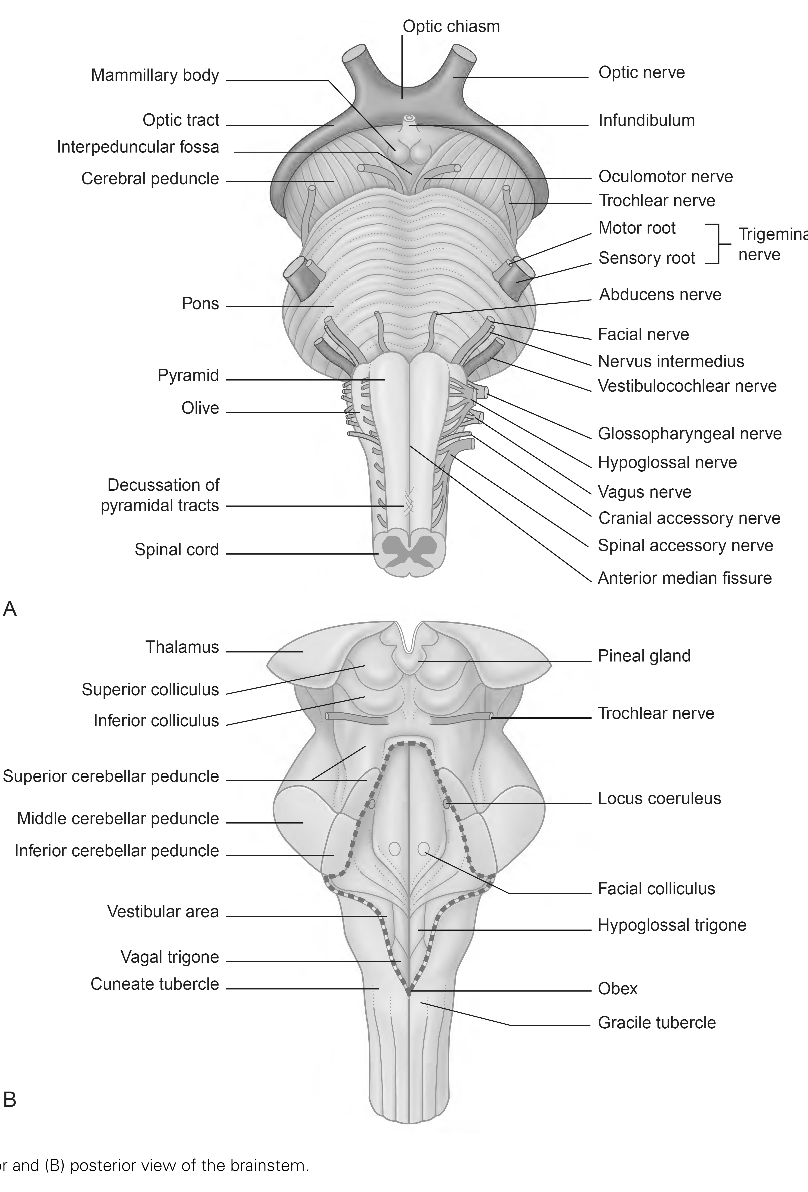
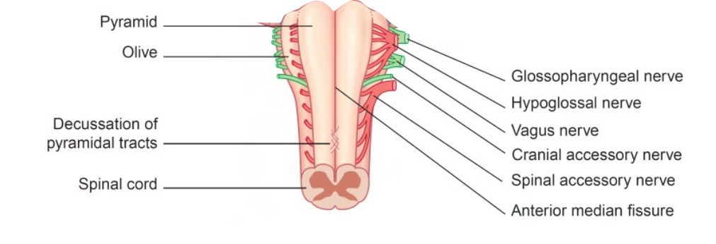
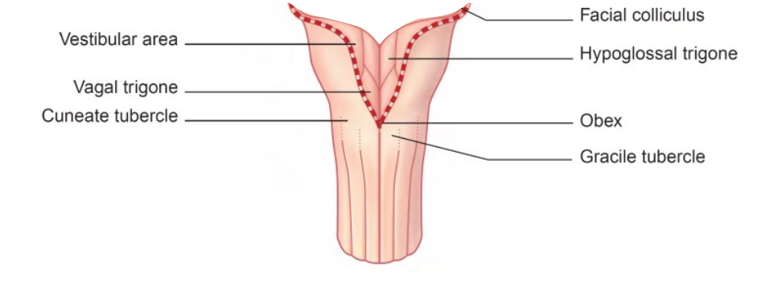
The medulla oblungata

Slide 6
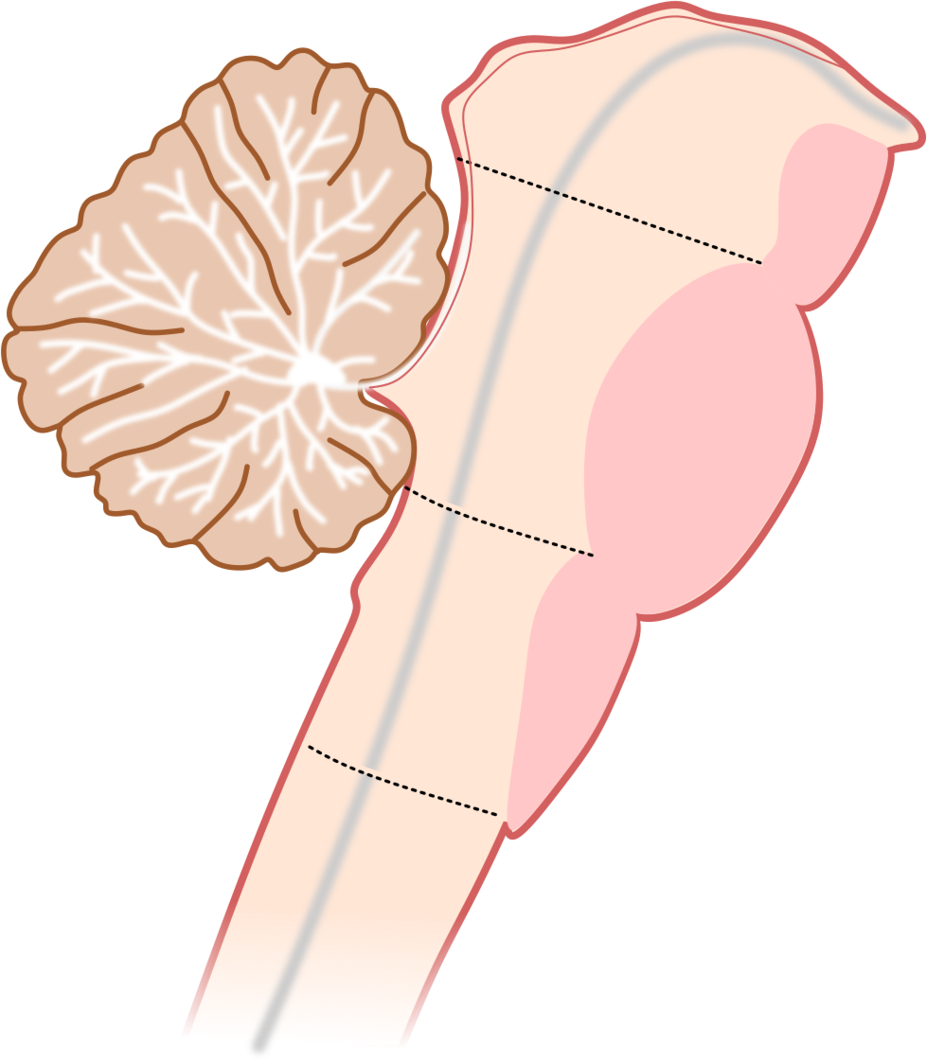
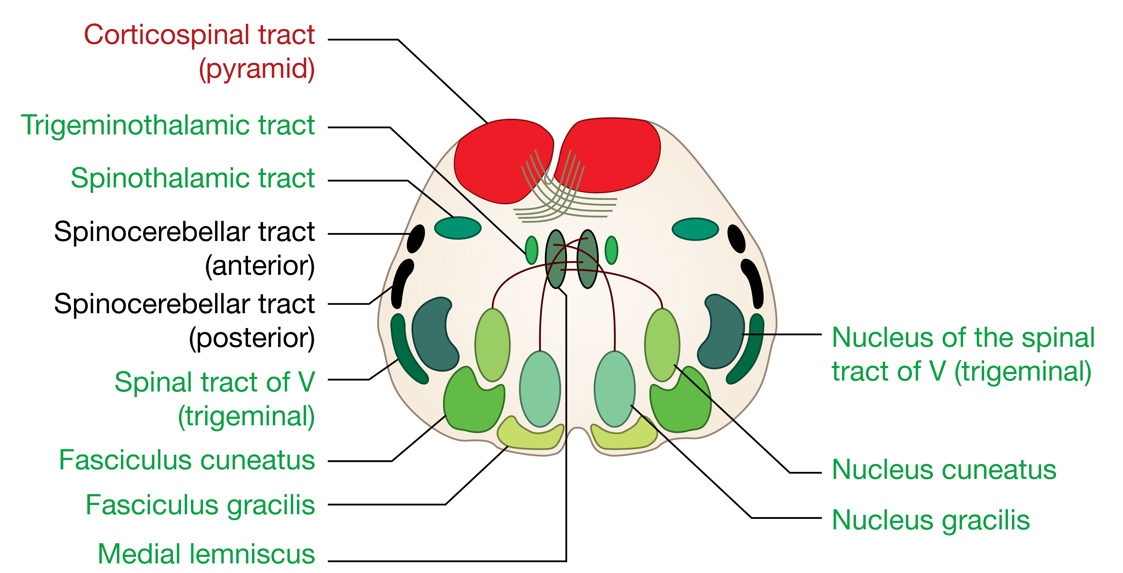
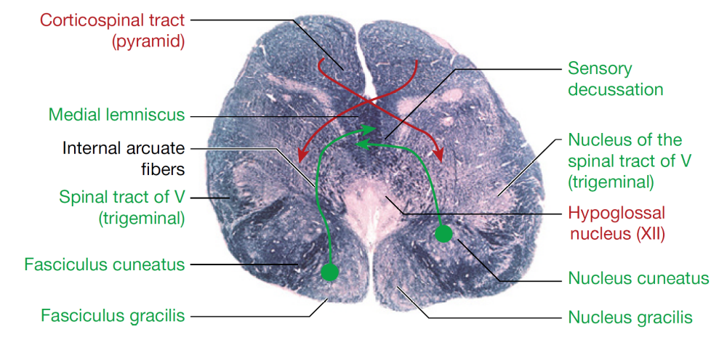
The medulla oblungata
Midbrain
Pons
Medulla
Oblungata
Sensory
Motor

Slide 7
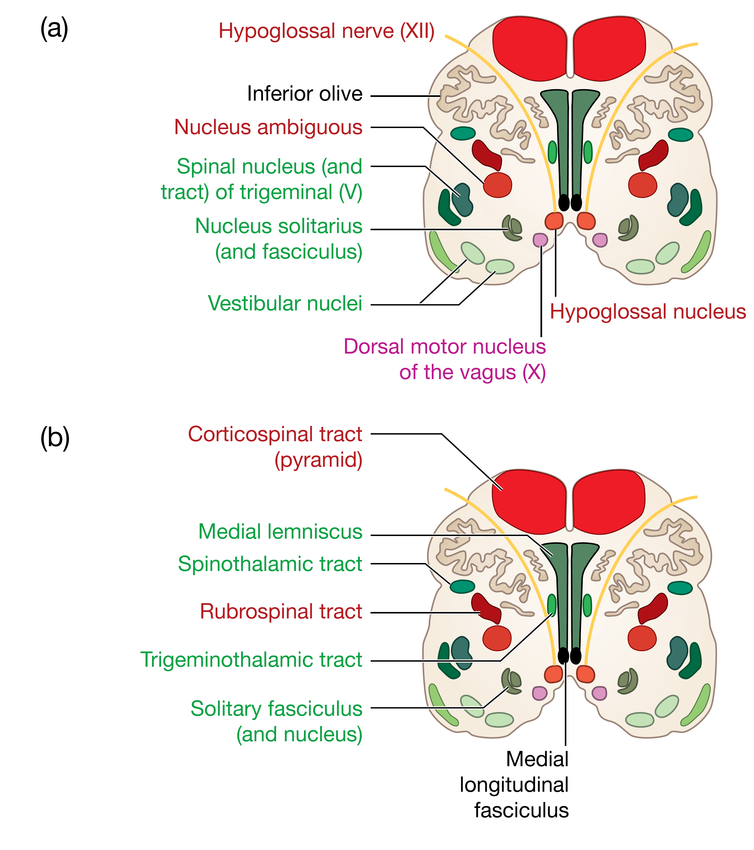
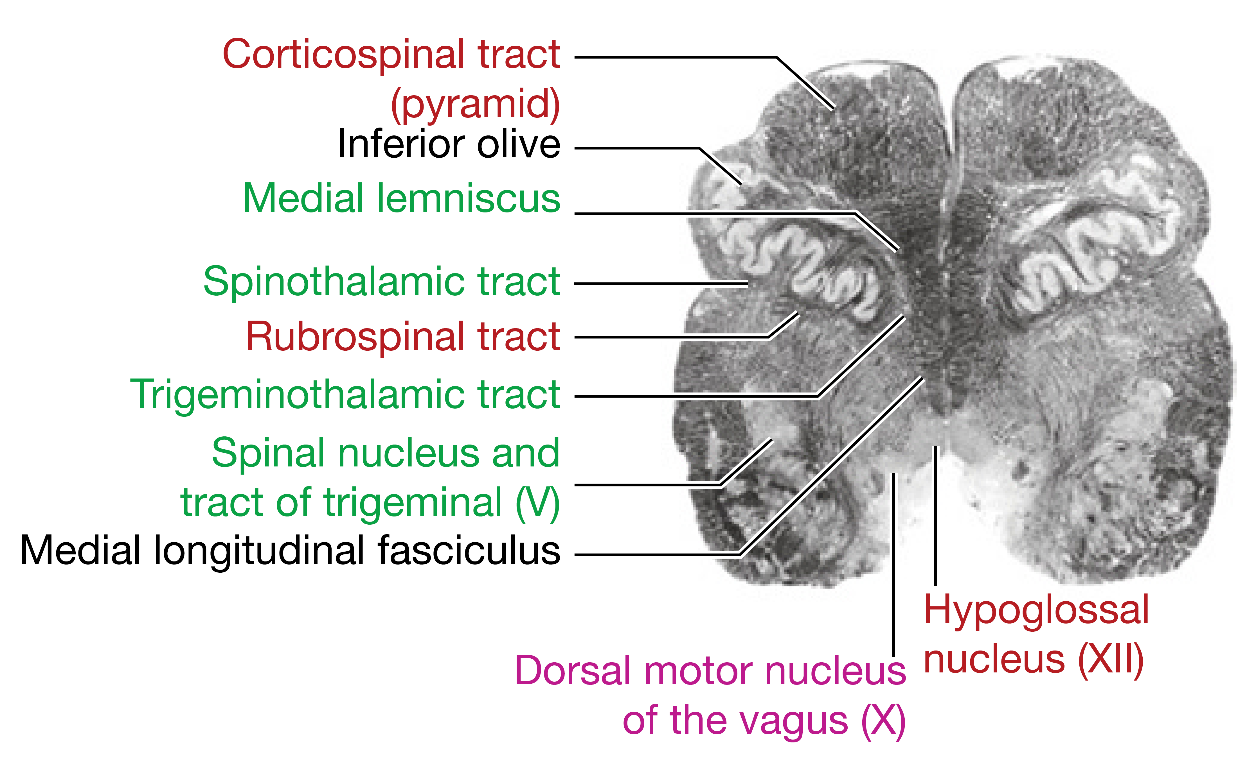
The medulla oblungata
Midbrain
Pons
Medulla
Oblungata
Sensory
Motor

Slide 8
Cranial nerves of the medulla oblungata

Slide 9
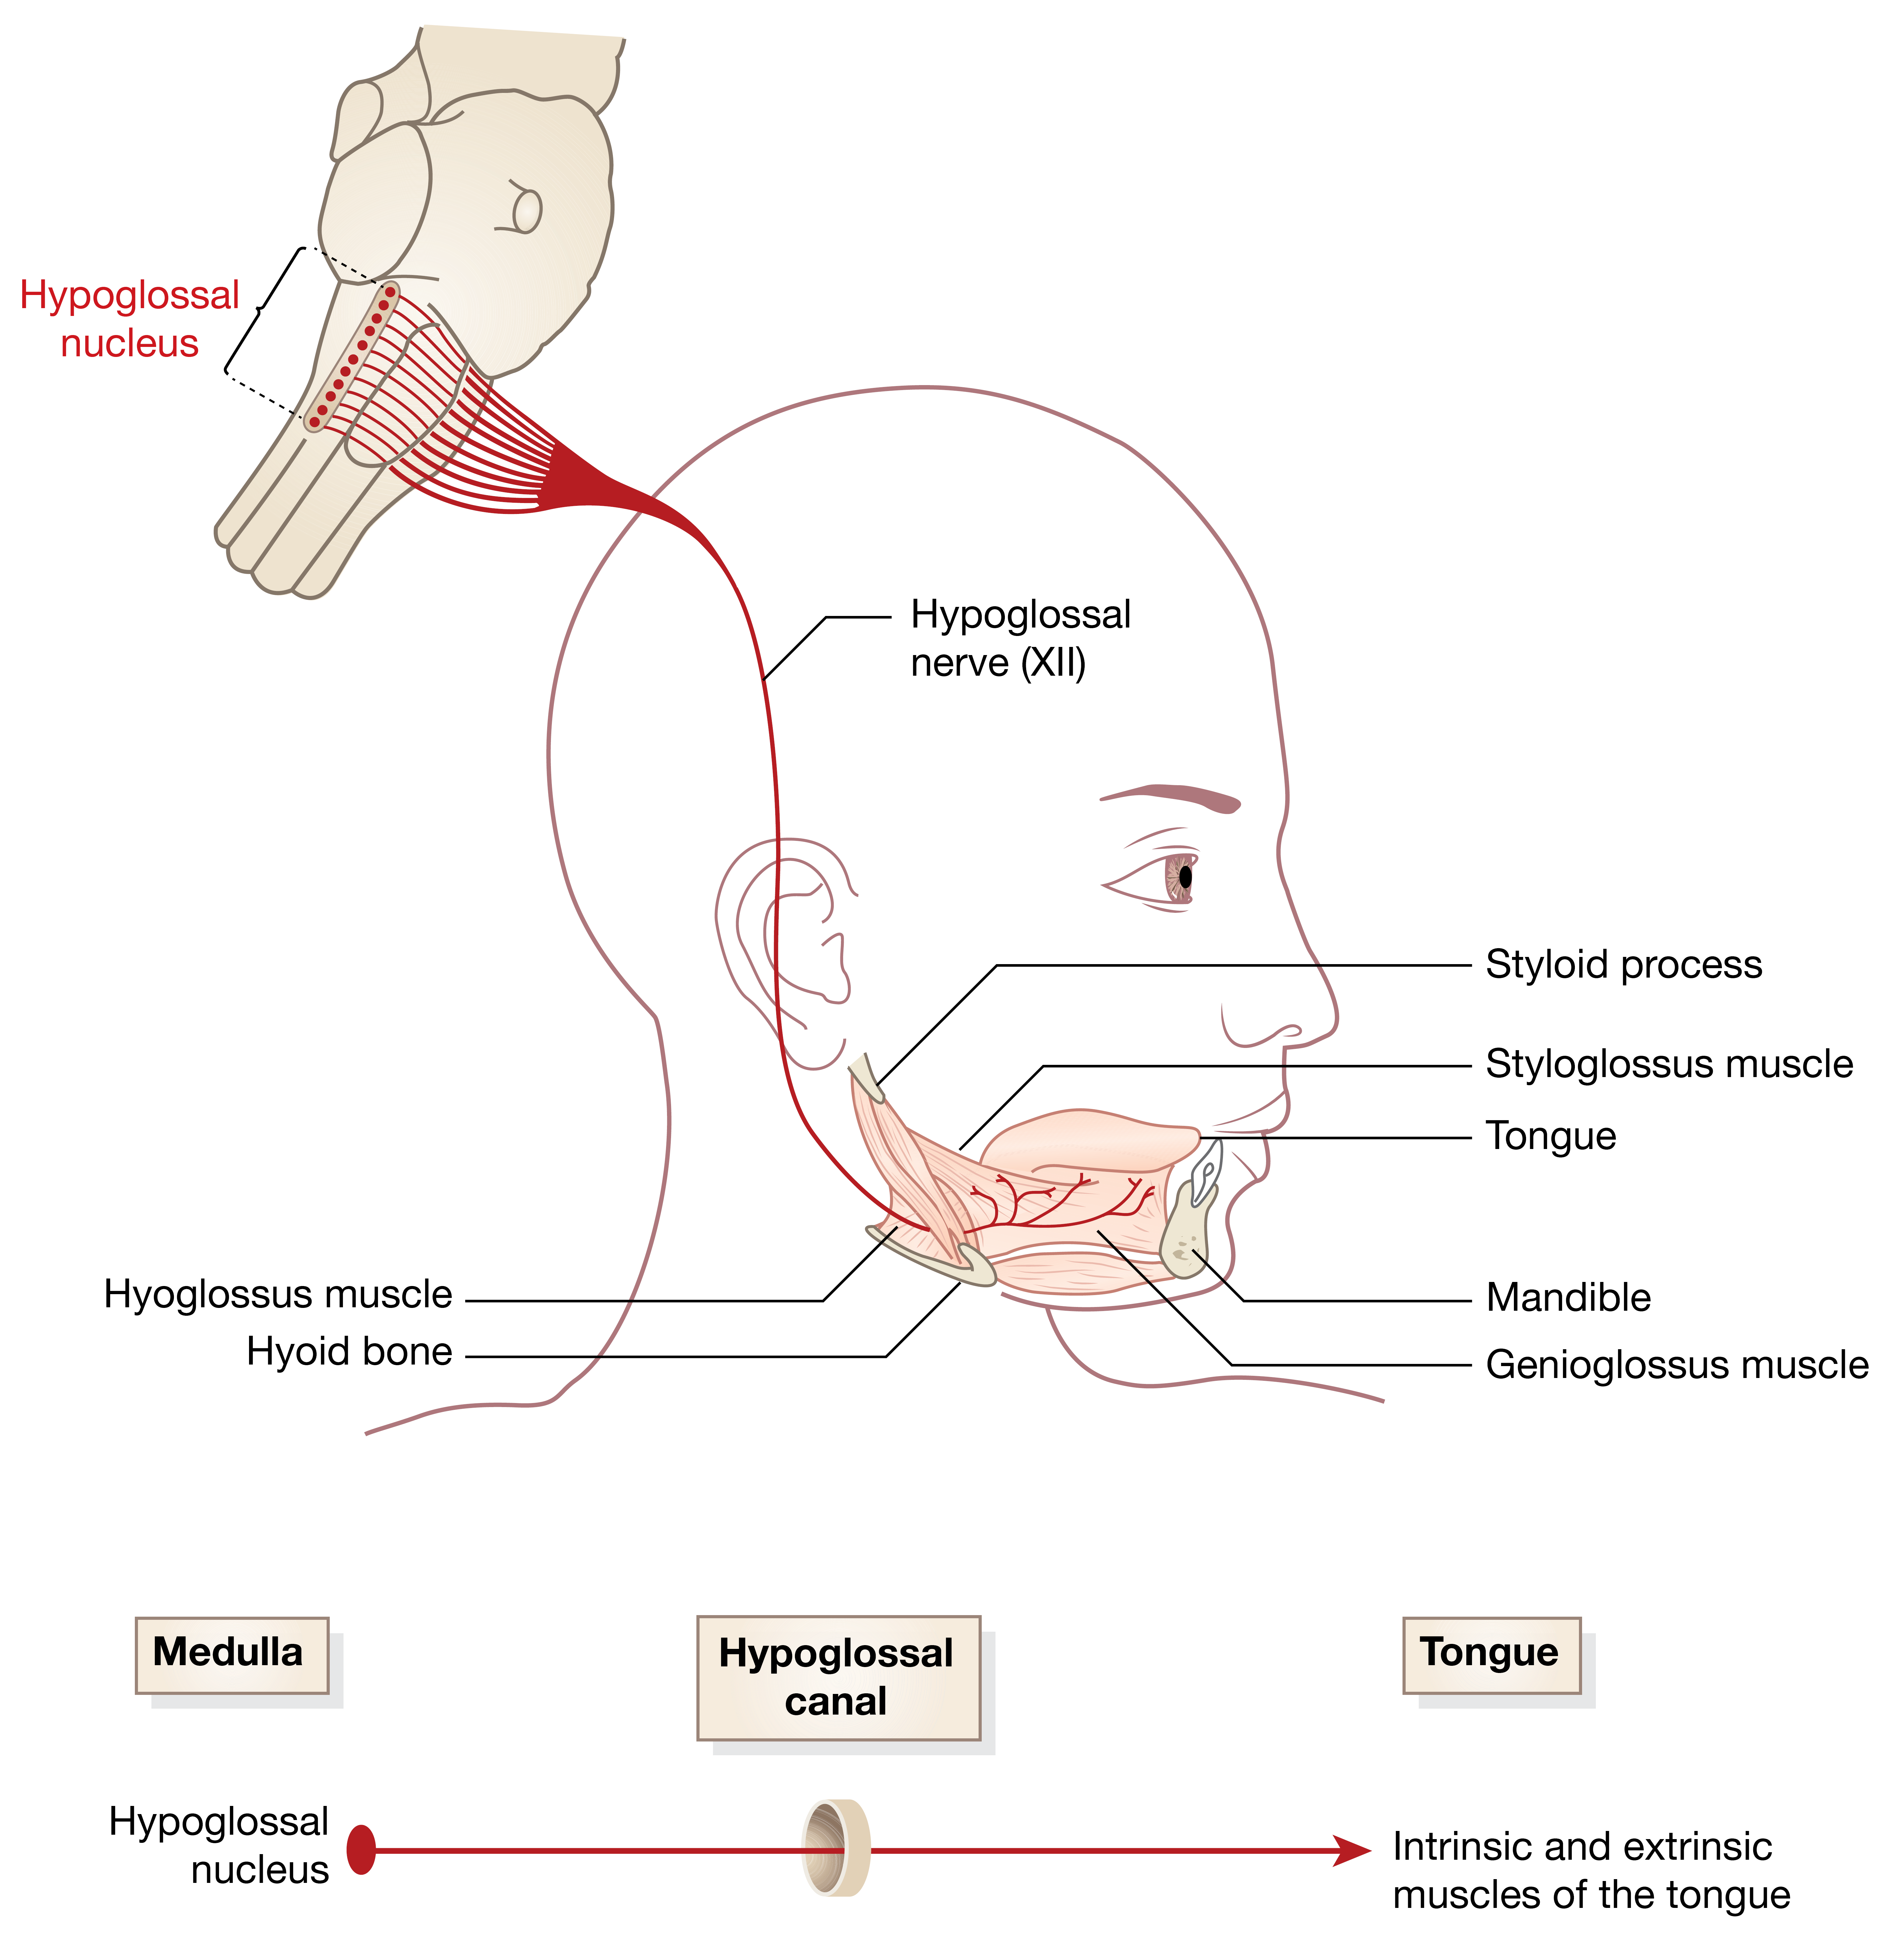
XII - Hypoglossal
Exit from medulla:
Pre-olivary sulcus

Slide 10
XI - Accessory

Slide 11
X - Vagus
Exit from medulla:
Post-olivary sulcus

Slide 12
X - Vagus

Slide 13
IX - Glossopharyngeal nerve
Exit from medulla:
Post-olivary sulcus

Slide 14
Cranial nerves of the medulla
Number | Nerve | Nuclei | Targets
XII | Hypoglossal | Hypoglossal nucleus | Tongue muscles
XI | Accessory | Spinal accessory nucleus (anterior horn cells of upper cervical nerves) | Trapezius and sternocleidomastoid muscles
X | Vagus | Spinal trigeminal nucleus Nucleus solitarious Nucleus Ambiguous Dorsal motor nucleus of the vagus | General sensation in larynx, epiglottis and small portion of external auditory meatus Taste from the epiglottis Chemoreception from the carotid sinus and aortic arch Diffuse visceral sensation from the thoracic and abdominal viscera Muscles of the palate, pharynx, and larynx Cardiac muscle of the heart and the smooth muscle of the respiratory system and digestive system
IX | Glossopharyngeal | Spinal trigeminal nucleus Nucleus solitarious Nucleus Ambiguous Inferior salivatory nucleus | Taste and general sensation in posterior 1/3 tongue General sensation in nasal and oral pharynx Chemoreception from the carotid body Stylopharyngeus muscle Parotid salivary gland

Slide 15
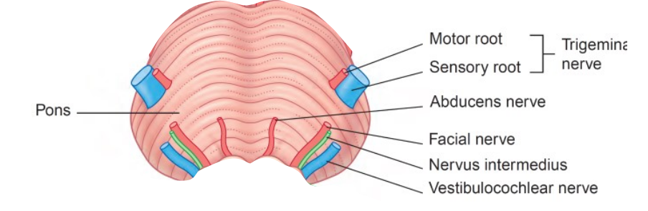
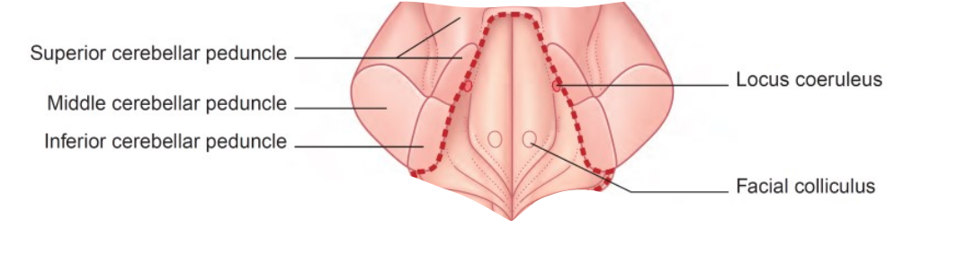
The pons

Slide 16
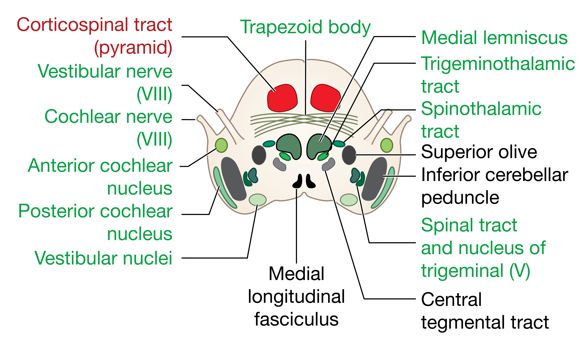
The pons
Midbrain
Pons
Medulla
Oblungata
Sensory
Motor

Slide 17
The pons
Midbrain
Pons
Medulla
Oblungata
Sensory
Motor

Slide 18
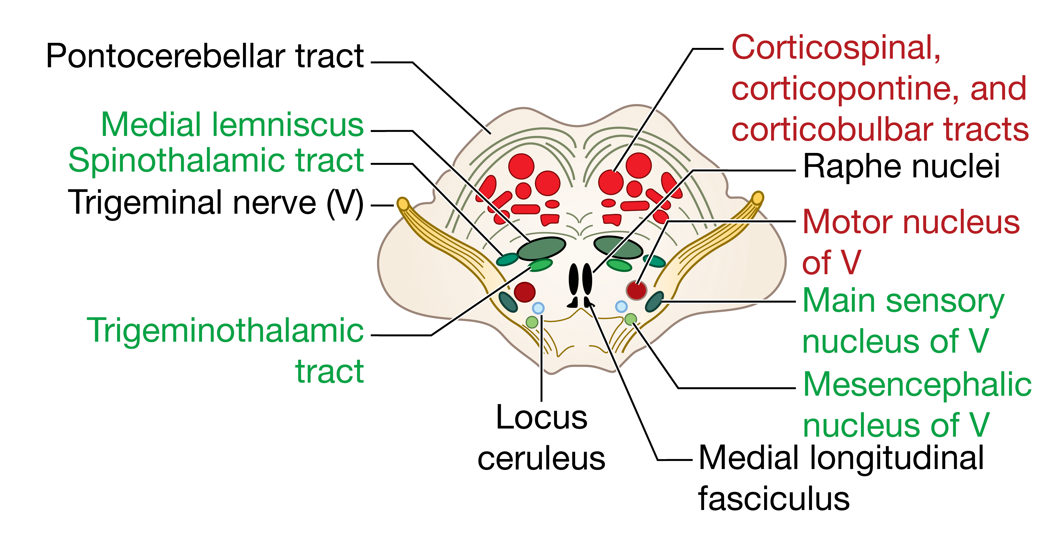
The pons
Midbrain
Pons
Medulla
Oblungata
Sensory
Motor

Slide 19
The pons
Midbrain
Pons
Medulla
Oblungata
Sensory
Motor

